Slide 1
Case Study 2: Boxify’s E-commerce Customer Churn Analysis
Sai Jhansi Kongara
Student at Sharpener Tech
1

Slide 2
AIM
Boxify is an online subscription box service that delivers monthly lifestyle and Handpicked products to customers.
Analyze Boxify’s E-commerce Customer churn over the last 3 years to provide necessary business recommendations to improve customer retention and reduce revenue loss. .
Business Objective:
Reduce churn rate by 5–10% over the next 6 months.
Identify high-risk customer segments.
Recommend strategies to retain subscribers and increase loyalty.
Tools Used:
Microsoft Power BI
Spreadsheet
ChatGPT
2

Slide 3

Business Analysis

Slide 4
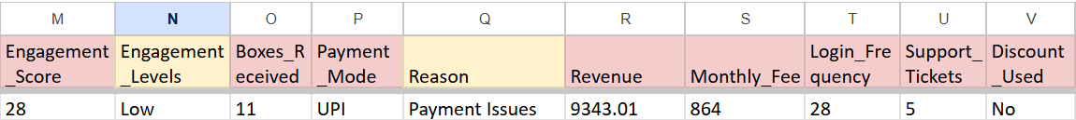
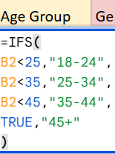
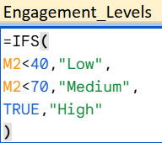
Dataset & EDA
Chatgpt driven Dataset.
Replacing null Values are with “0”.
Blank Text entries with “Unknown".
3000 Boxify’s E-commerce customer entries from
last 3 years FY 2023 - 2025
2

Slide 5
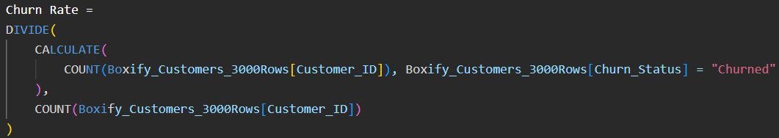
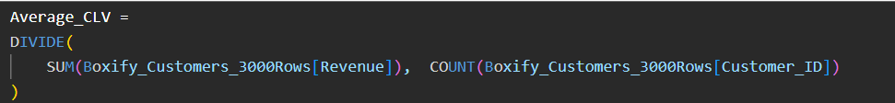
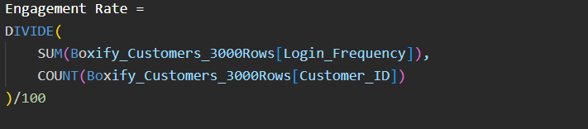
DAX Measures
10

Slide 6
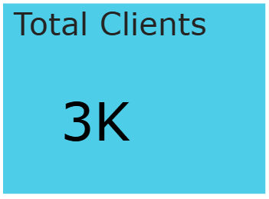
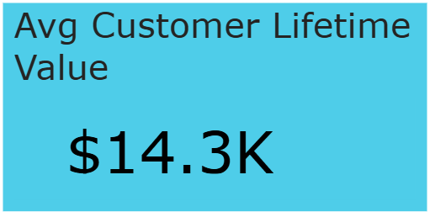
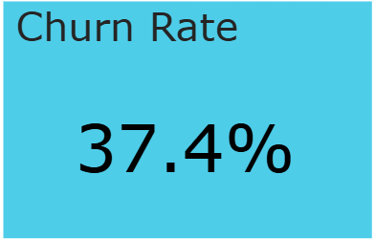
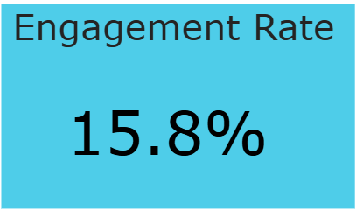
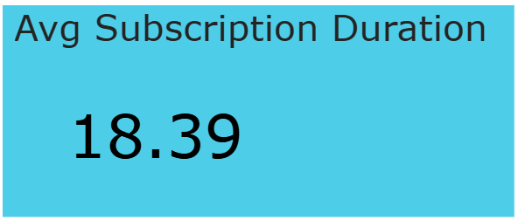
KPI Summary
17

Slide 7

Business Insights and Recommendations
in terms of Quick wins and long-term strategies
7

Slide 8
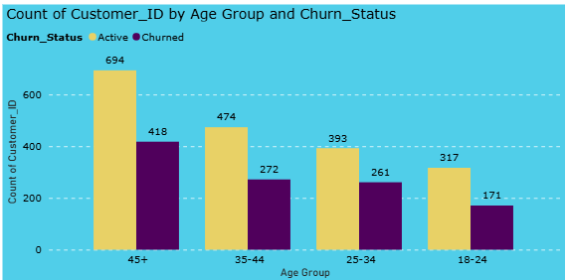
Churn Analysis
45+ showed higher churn also retention.
Younger customers may require:
Better engagement
Personalized offers
4

Slide 9
Churn Analysis
Quick wins(0–3 Months) Recommendations to actions:
Launch personalized email campaigns for inactive customers.
Long-term strategies(3–12 Months)
Collect customer feedback through surveys.
4

Slide 10
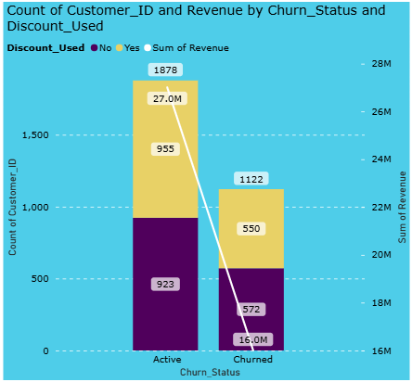
Churn Analysis
Revenue Statistics:
5

Slide 11
Churn Analysis
Quick wins:
Offer referral discounts and promotional incentives may reduce churn
Long-term strategies:
Optimize subscription plans and pricing strategies.
5

Slide 12
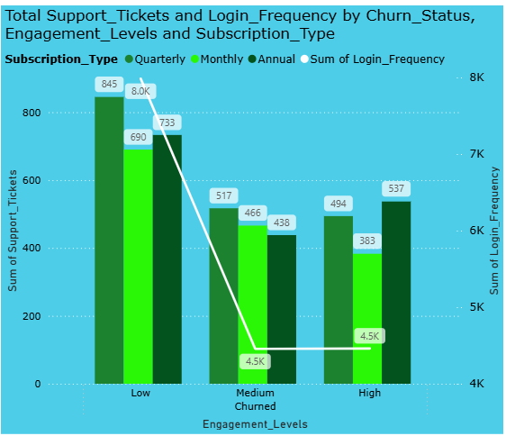
Churn Analysis
Churn Analysis
6

Slide 13
Churn Analysis
Quick wins:
Improve customer support response time
Long-term strategies:
Perform customer journey and behavior analysis.
6

Slide 14
Conclusion
Analyzed customer churn patterns for Boxify subscription service.
Used Google Sheets and Microsoft Power BI for data cleaning and dashboard analysis.
Identified low engagement, high support tickets, and monthly plans as major churn factors.
Created dashboards to analyze customer segments, engagement, and revenue impact.
Recommended loyalty programs, personalized offers, and engagement strategies to improve retention.
Resource Page
Want more flexibility as a presenter? Record your presentation to engage in a way that works for you — and let your audience watch in a way that works for them.
Delete or hide this page before sharing.
20

Slide 15

Any Questions/feedback?
Check out Working Model Here:
Case Study 2 Boxify E-commerce Customer Churn Analysis
THANK YOU
Connect me at:
Sai Jhansi Kongara

